Slide 1
Sphero Development Project- Group 2
By Victor Davidson & Jack Miller

Slide 2
Roles
Lead Developer-Jack Miller
Primarily responsible for development of sphero algorithm
Project Manager- Victor Davidson
Ensured deadlines met, meetings and communications are strong and frequent

Slide 3
Summary
Each course has a corresponding algorithm utilized effectively for completion.
Meetings were conducted in order to plan, develop, and collaborate on the algorithms necessary for project completion
Trial and error methods were used in order to fine-tune each algorithm to effectively run the course
GitHub was used to effectively collaborate, as well as provide a concise, easy to follow submission
The codes we develop will serve as a foundation of learning for future students to utilize when working with Sphero
A design document, Gannt chart, meeting schedule, and requirements table were all developed to keep both developers on track and prepared for due dates.

Slide 4
Product Description
All systems provided to allow Sphero to function were updated.
User Characteristics
All users in this context were somewhat "beginners" and used Sphero and it's block code
All devices included by users had access to Sphero
Sharing between users was protected
Data collected was protected
Use of both Microsoft Excel and Word

Slide 5
Requirements
Has all the requirements needed in order to design a functioning system
All comments provided were provided accurately
The priority of the requirements were noted as well
Date of requirement was noted
Completion of requirement was would be signed off by both team members

Slide 6
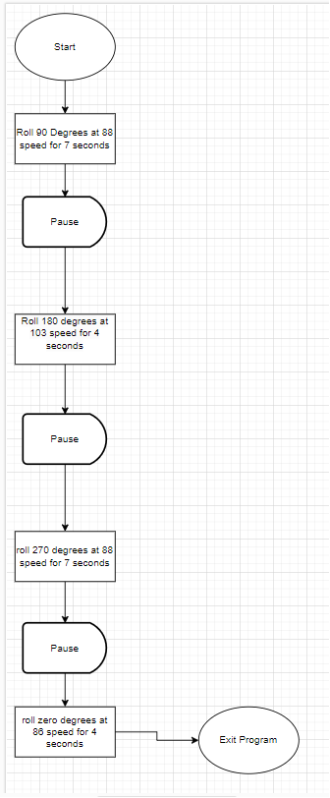
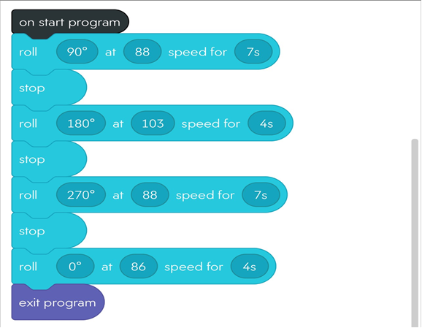
Flowcharts/Algorithms (Endurance)

Slide 7
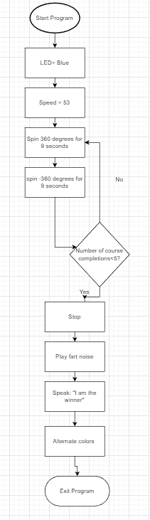
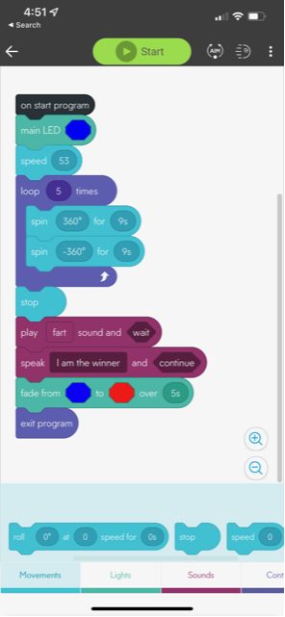
Flowcharts/Algorithms (Accuracy)

Slide 8
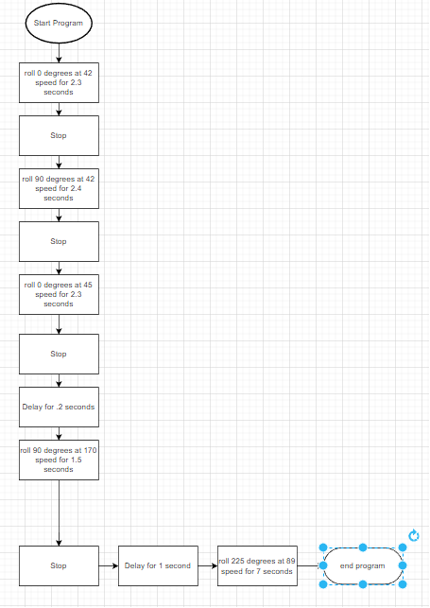
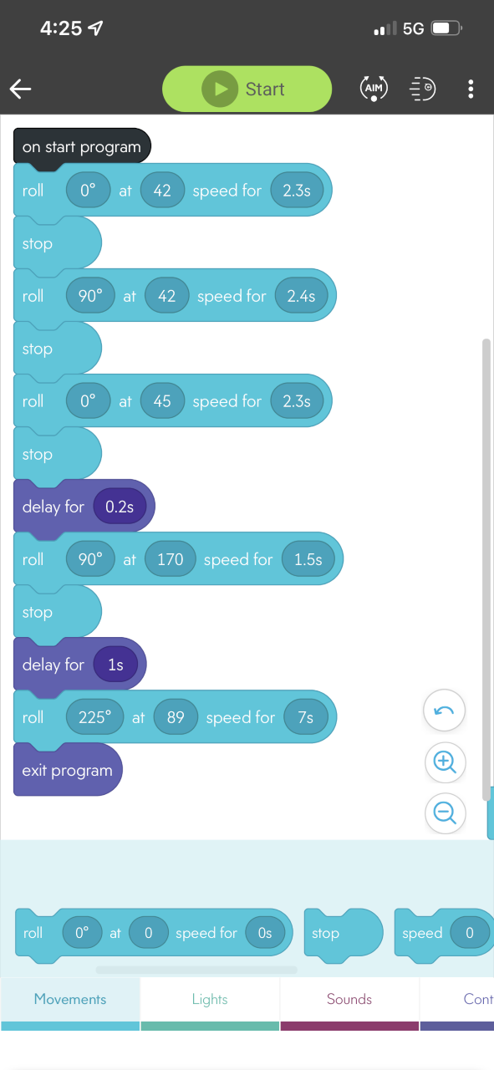
Flowcharts/Algorithms (Agility)

Slide 9
Github Repositories
Endurance- https://github.com/jackm39458/Triathalon-Work_Endurance.git
Accuracy- https://github.com/jackm39458/Triathalon_accuracy.git
Agility- https://github.com/jackm39458/agility.git
Presentation- https://github.com/jackm39458/Presentation.git

